Slide 1
NALAIYA THIRAN PROJECT
Exploratory Analysis of Rainfall Data in India for Agriculture

Slide 2


EXPLORATORY ANALYSIS OF RAIN FALL DATA IN INDIA FOR AGRICULTURE
APPLIED DATA SCIENCE
GOVERNMENT COLLEGE OF ENGINEERING, ERODE
(Fomerly IRTT)
TEAM ID : PNT2022TNID44288
DEPARTMENT
of
COMPUTER SCIENCE AND ENGINEERING
INDUSTRY MENTOR:
LALITHA GAYATHRI
FACULTY MENTOR:
Dr.A.KAVIDHA
FACULTY EVELUATOR: SPOC:
N.VASUKI Dr.G.GOWRISON
TEAM MEMBERS:
731119104016 - GOWTAMKUMAR S S (TEAM LEAD)
731119104006 - BALAJI V
731191104008 - BOOBATHI T
731119104015 - GOUSHIK A

Slide 3
Problem Statement
Rainfall has been a major concern these days. Weather conditions have been changing for time being. Rainfall forecasting is important otherwise, it may lead to many disasters. Irregular heavy rainfall may lead to the destruction of crops, heavy floods that can cause harm to human life. It is important to exactly determine the rainfall for effective use of water resources, crop productivity, and pre-planning of water structures.

Slide 4
Proposed Solution
The Solution is to make use of modern Machine Learning techniques such as Logistic Regression, Decision Tree, Random Forest and Boosting methods to better forecast the chances of Rainfall on any particular day.

Slide 5
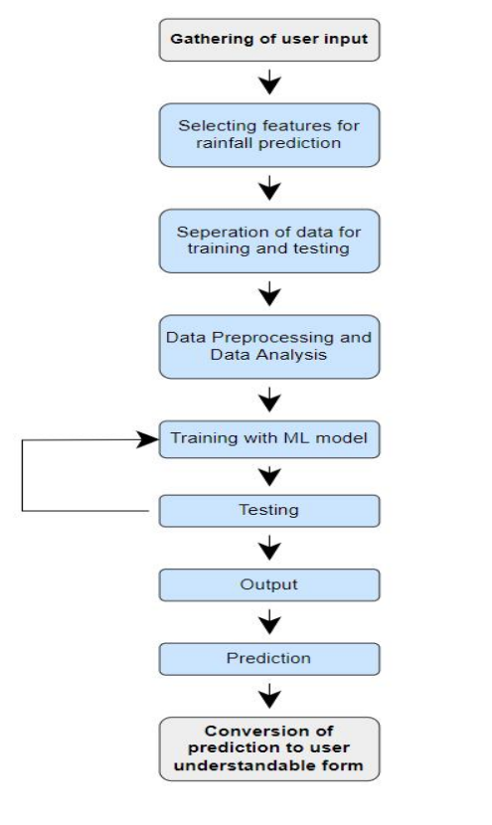
Technical Architecture

Slide 6
Unique features
The given dataset is highly imbalanced. Only about 10% of the dataset contains ‘Yes’ for the RainToday column. So we used class weights method to account for the imbalance.
Our solution doesn’t make use of scaler method to standardize the user’s input and Label encoder to encode. So it’s simple yet effective.

Slide 7
Performance Metrics
Accuracy – 0.846
Precision – 0.724
Recall – 0.484
F1 Score – 0.580

Slide 8
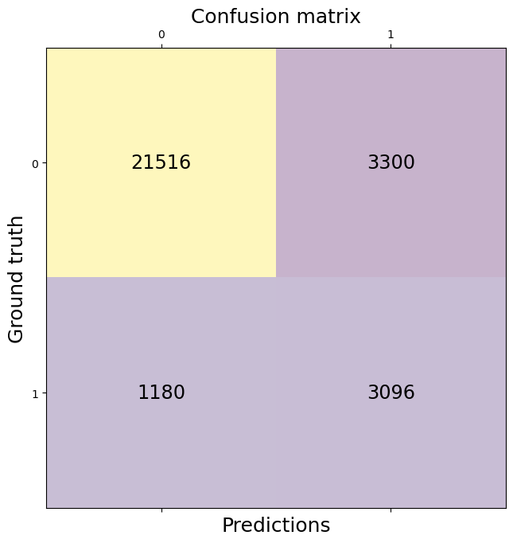
Performance Metrics

Slide 9
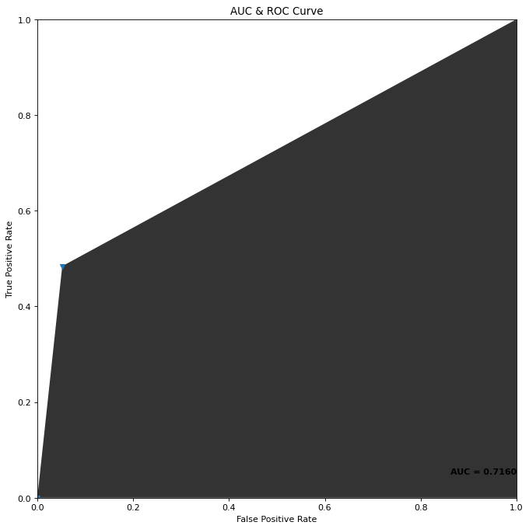
Performance Metrics

Slide 10
Future Scope
The Proposed solution can able to forecast the chances of rainfall for Today and Tomorrow. But it cannot able to predict the chances of rainfall in a short period of time, say about 1-2 hours (also called as Precipitation Nowcasting). Nowcasting is essential for sectors like water management, agriculture, aviation, emergency planning, and outdoor events. In Future, we would like to extend our proposed solution to solve the problem of Nowcasting.

Slide 11
Thanks !

